Slide 1

What is the Network ?

Slide 2
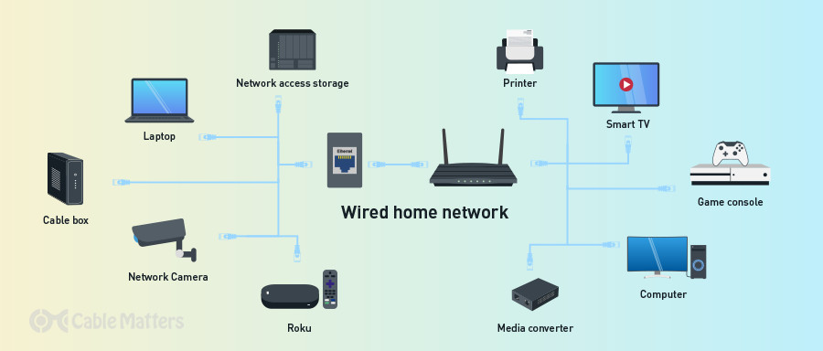
What makes up a basic network?
A network consists of two or more computers that are linked in order to share resources (such as printers and CDs), exchange files, or allow electronic communications. The computers on a network may be linked through cables, telephone lines, radio waves, satellites, or infrared light beams.

Slide 3
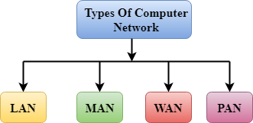
Computer networking, is the practice of transporting and exchanging data between nodes over a shared medium in an information system
An example of networking is sharing and acquiring information between different divisions of the same company to share information and solve business problems. An example of networking is linking the entire network of computers to a print server to allow each workstation to have the ability to print documents
Types of Networking,
A computer network is a group of computers linked to each other that enables the computer to communicate with another computer and share their resources, data, and applications. A computer network can be categorized by their size. A computer network is mainly of four types: LAN(Local Area Network)

Slide 4
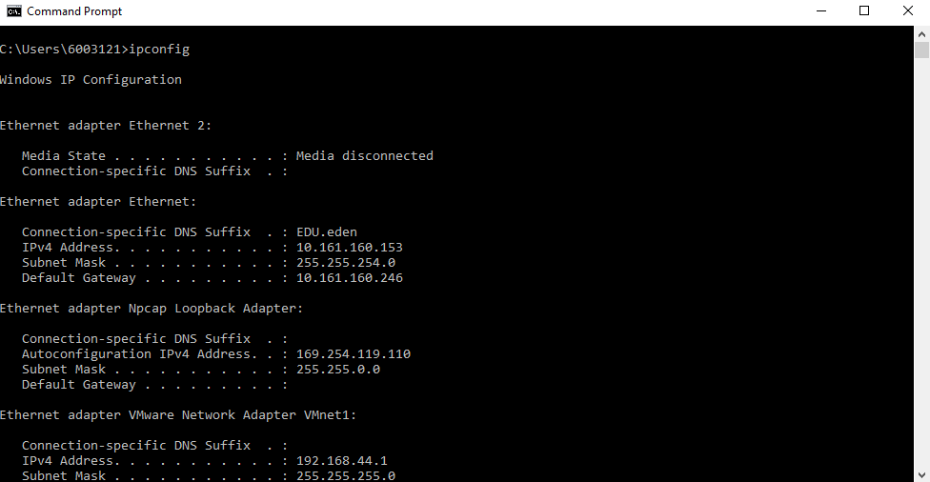
What is the main purpose of networking?
A computer network comprises two or more computers that are connected—either by cables (wired) or Wi-Fi (wireless)—with the purpose of transmitting, exchanging, or sharing data and resources.
To Check IP Address
Open →command prompt → Type ipconfig

Slide 5
Internet Protocol address(IP address)
An IP address, or Internet Protocol address, is a series of numbers that identifies any device on a network. Computers use IP addresses to communicate with each other both over the internet as well as on other networks
What is subnet mask example?
Subnet masks are also expressed in dot-decimal notation like an IP address. For example, the prefix 198.51. 100.0/24 would have the subnet mask 255.255. 255.0.
What is my IP with subnet mask?
Go to System Preferences > Network. Select your network and click Advanced. Click on TCP/IP tab and you will find your IP address along with the subnet mask

Slide 6
What is meant by default gateway?
The default gateway is the path used to pass information when the device doesn't know where the destination is. More directly, a default gateway is a router that connects your host to remote network segments. It's the exit point for all the packets in your network that have destinations outside your network.
What is Cisco Packet Tracer?
Cisco Packet Tracer is a comprehensive, networking technology learning program that offers a unique combination of realistic simulation and visualization experiences, assessment and activity authoring capabilities, and opportunities for multiuser collaboration and competition.
It can be used to create complicated network typologies, as well as to test and simulate abstract networking concepts. It acts as a playground for you to explore networking and the experience is very close to what you see in computer networks.
Packet Tracer allows users to drag and drop routers, switches, and other network devices to create simulated network topologies.

Slide 7
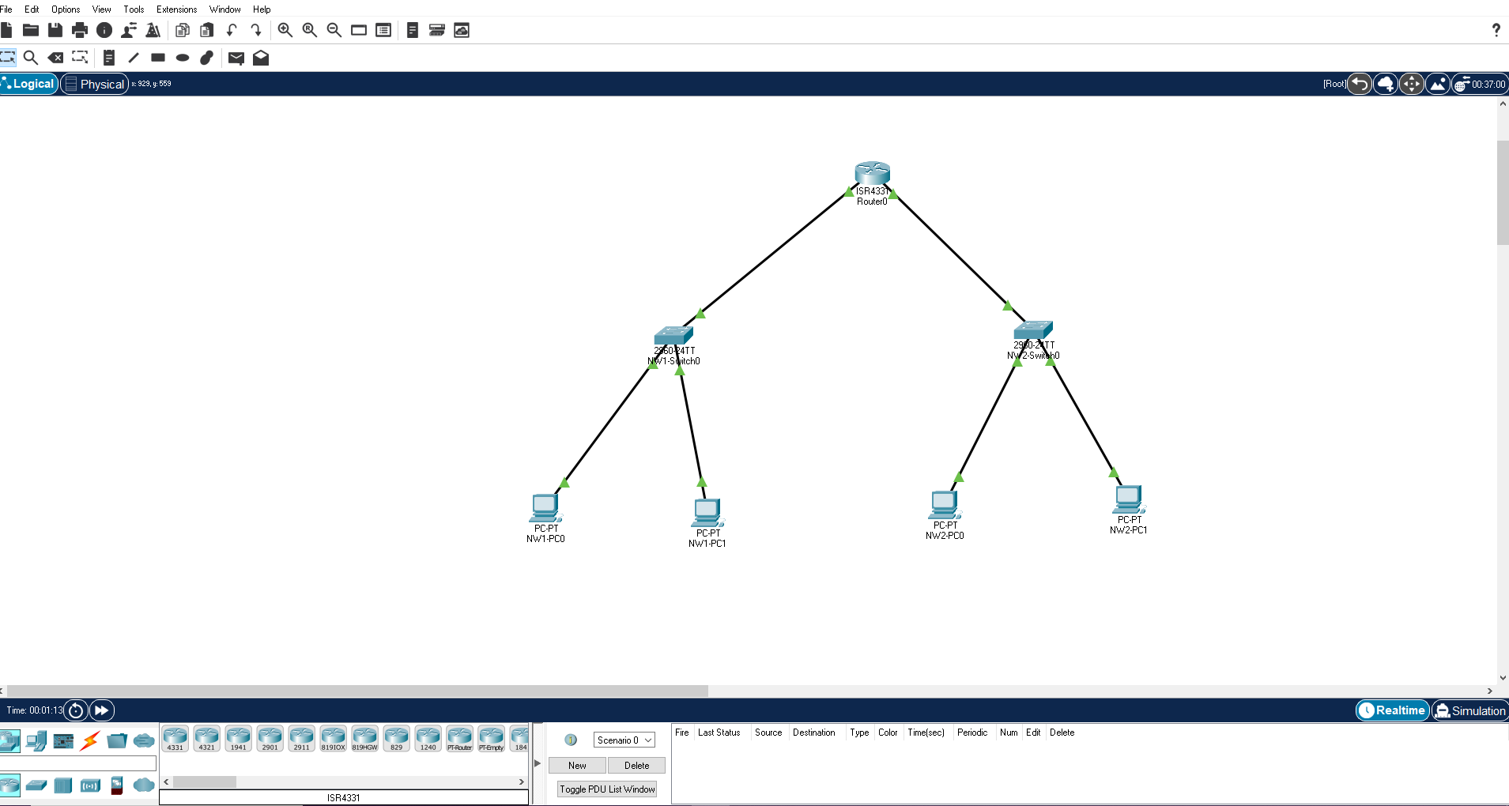
What is switch in Cisco Packet Tracer?
Switch allows us to set IP address on interface level. IP address assigned on interface is used to manage that interface.
To manage entire switch, we must assign IP address to VLAN1( Default VLAN of switch). We also must set default gateway IP address from global configuration mode.

Slide 8
Features of Cisco Packet Tracer
Cisco Packet Tracer supports a multi-user system that allows many users to connect various topologies across a computer network. Instructors can also build exercises for students to perform using Packet Tracer.
Supports feature expansion via additional programmes that use an API to improve Cisco Packet Tracer's capabilities in areas including curriculum and assessment delivery, gaming, accessibility, and interacting with real-world equipment.
The Enhanced Physical Mode transports you to a virtual lab where you can simulate cabling devices on a rack. Refresh key skills such as device placement (Rack & Stack), on-device power switching, device port-to-port cabling (including cable selection and management), troubleshooting, and more.
It can be downloaded for free through a Netacad account.
It enables its users to simulate the configuration relating to the Cisco routers and can be accessed anywhere anytime.
The Network Controller allows you a centralised dashboard to see the network's state, instantly discover and diagnose issues, and push configuration changes to all managed devices at once, whether you use its Web GUI or its APIs. You may also use real-world programmes on your computer to access the Network Controller and run your own infrastructure automation scripts.
It can be accessed through unlimited devices.
Provides an interactive and self-paced environment.

Slide 9
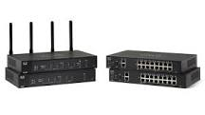
What is a router?
A router is a physical or virtual appliance that passes information between two or more packet-switched computer networks. A router inspects a given data packet's destination Internet Protocol address (IP address), calculates the best way for it to reach its destination and then forwards it accordingly.
What are the 2 types of routers?
Wired and wireless routers These routers are mostly used in homes and small offices.
Wired routers share data over cables and create wired local area networks (LANs),
while wireless routers use antennas to share data and create wireless local area networks (WLANs).
Switches are key building blocks for any network. They connect multiple devices, such as computers, wireless access points, printers, and servers; on the same network within a building or campus. A switch enables connected devices to share information and talk to each other.

Slide 10
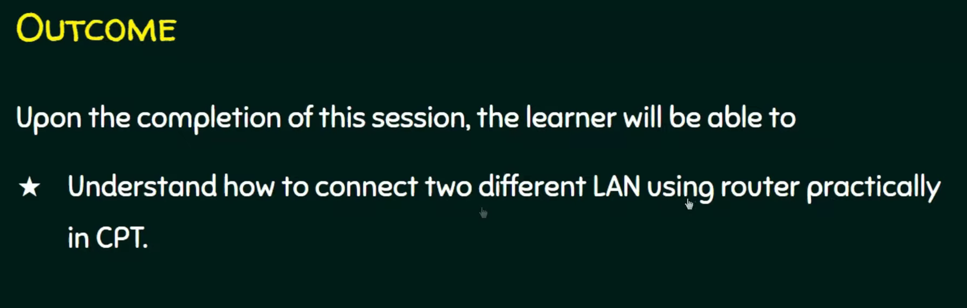

Slide 11
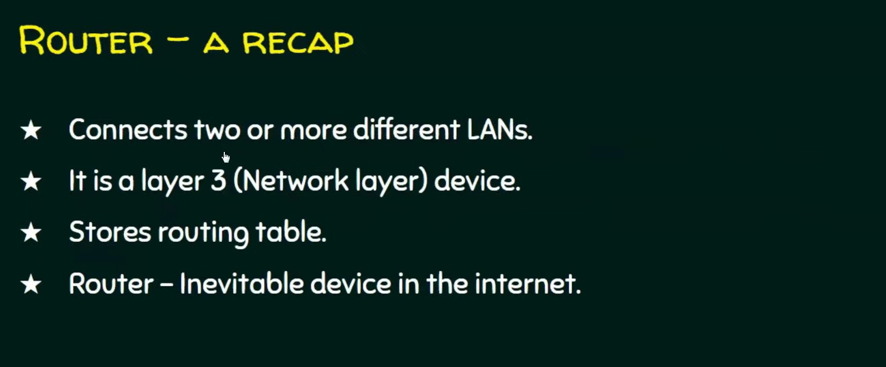

Slide 12
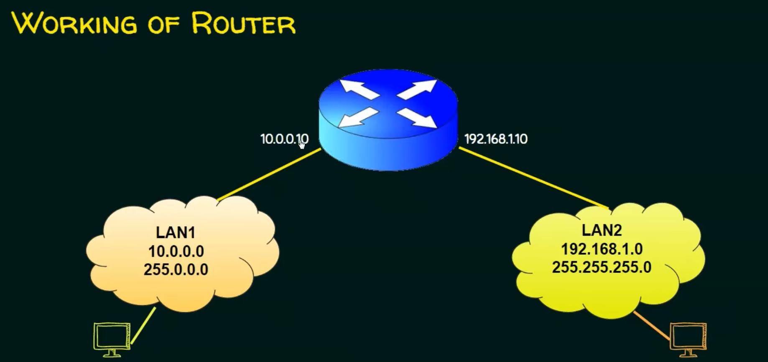

Slide 13
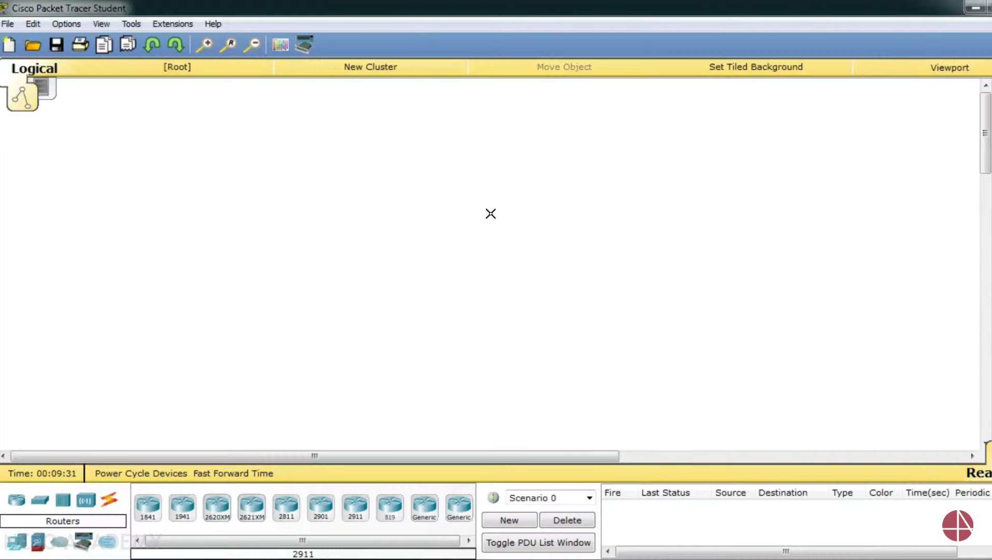

Slide 14
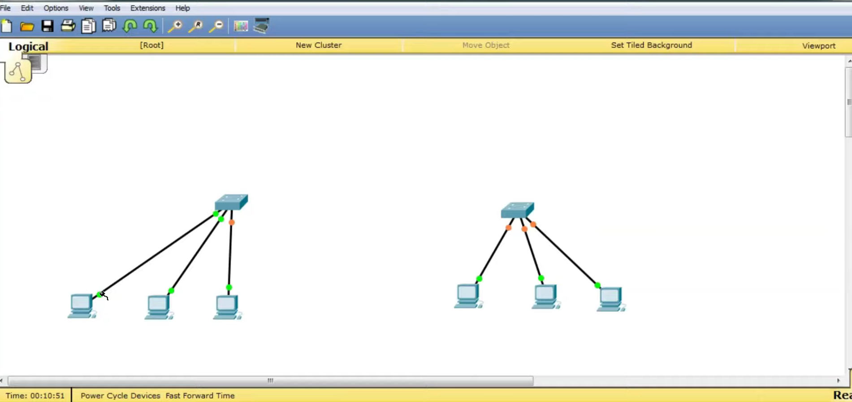

Slide 15
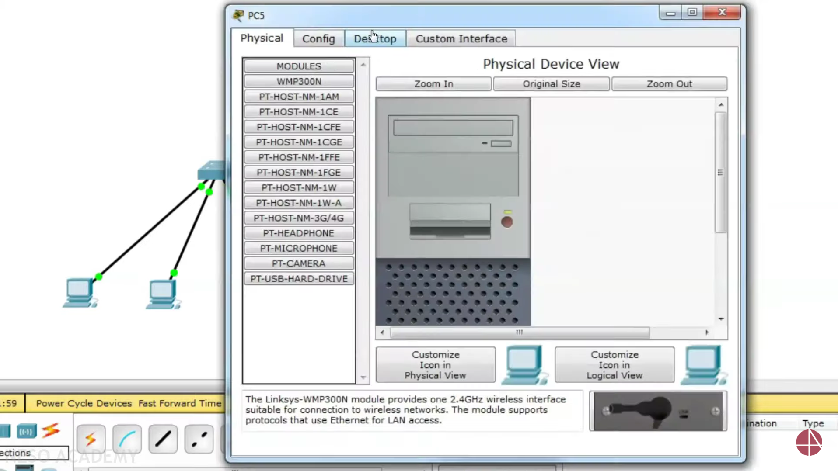

Slide 16
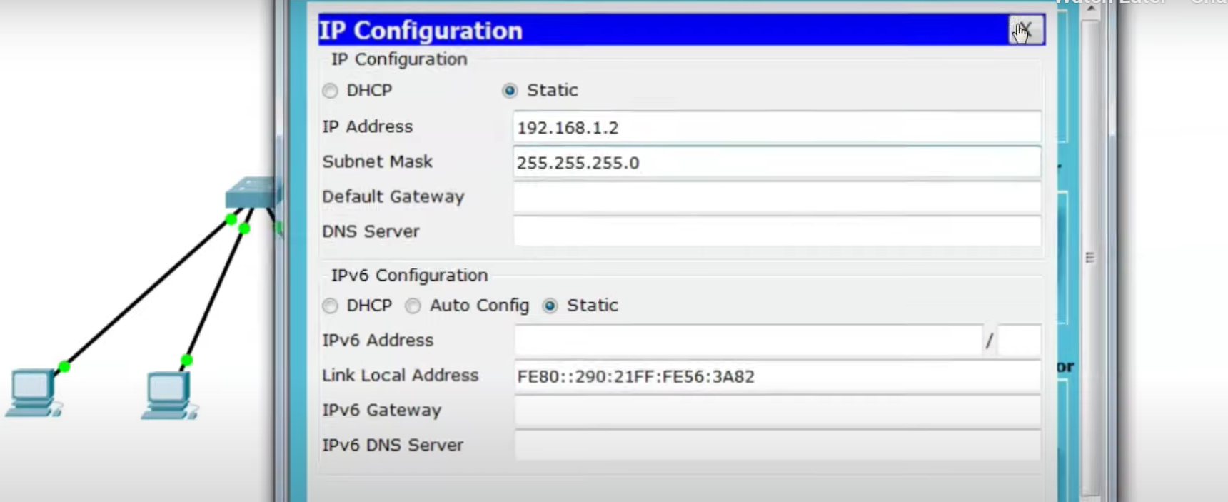

Slide 17
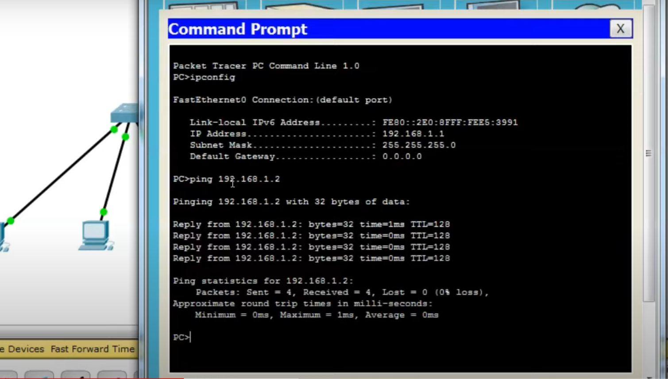

Slide 18
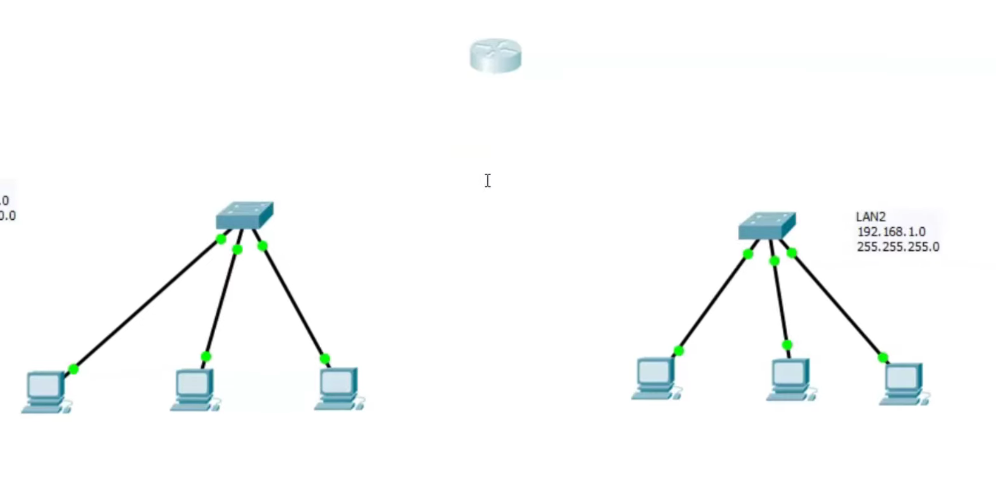
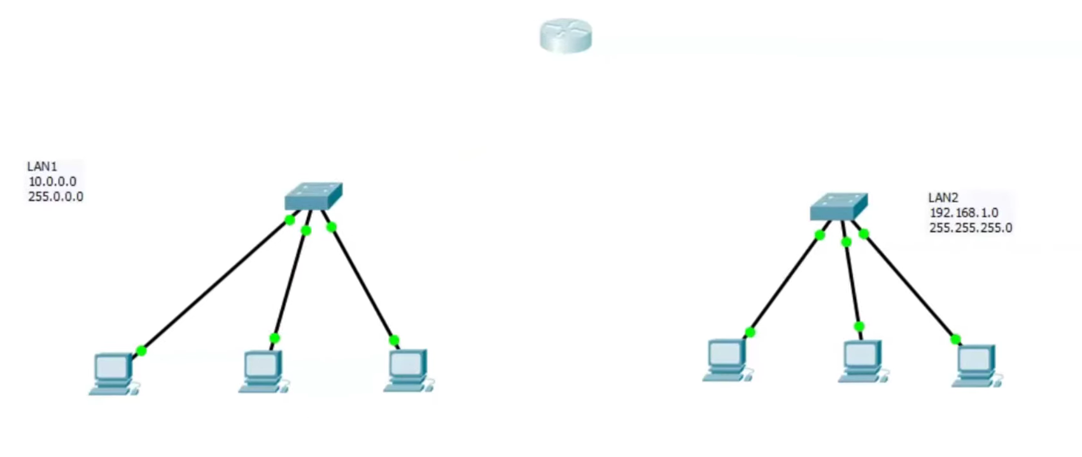

Slide 19
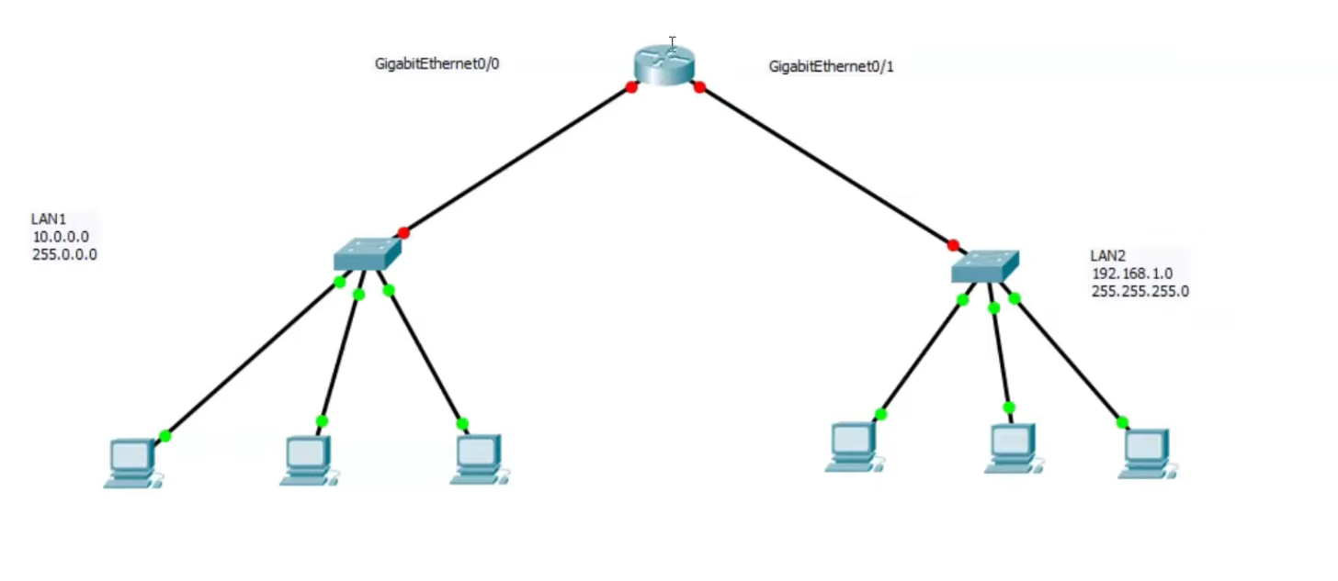

Slide 20
